Slide 1

Introduction to PowerPoint

Slide 2
What is PowerPoint?
PowerPoint is a software package designed to aid you as you create and deliver information primarily through electronic slide shows.

Slide 3
The Essence of PowerPoint
You
Focus on content and enter your information
Add additional elements to create interest
Motivate your audience while presenting
PowerPoint
Helps you organize your thoughts
Provides tools to make slide show creation easy
Allows flexibility in delivery and presentation

Slide 4

The Essence of PowerPoint
Audience Member
Receives presenter’s message in an organized way
Retains the message longer because of visual and auditory cues delivered in the presentation

Slide 5
Flexible Output
Computer slide shows
Interactive slide shows
Web-based presentations
Audience handouts
Outlines
Speaker notes

Slide 6

Enhanced Presentations
In addition to text, you can add:
Images and clip art
SmartArt diagrams
Audio and video
Animations
Charts and graphs
Tables

Slide 7
Ease of Use
Uses same Ribbon as other Office Applications
Organizes and presents menus according to what you are doing
Displays galleries with formatting and graphic options
Shows you how your changes will look with live previews

Slide 8
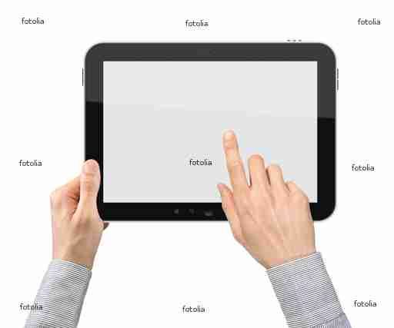
PowerPoint is a fun, easy tool to help you deliver your message!

